Slide 1

CAPSTONE PROJECT BATTLE OF NEIGHBORHOODS
CHOOSING LOCATION FOR
IT Training business

Slide 2
SUMMARY
Introduction: What project addresses and why. The problem and who it will help
Data: description and source of data.
Methodology: How I am addressing the problem.
Results: discuss the analysis results.
Observations noted and any recommendations you can make based on the results.
Conclusion

Slide 3
INTRODUCTION
A tech entrepreneur is looking to start an IT Training business in Nigeria And needs to decide between two locations; Oyo state or Rivers state
This project would help anyone who is looking for how to choose the best location to start an IT technical training school.

Slide 4
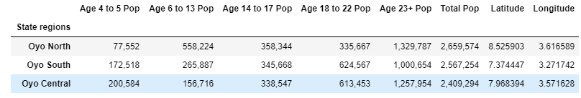
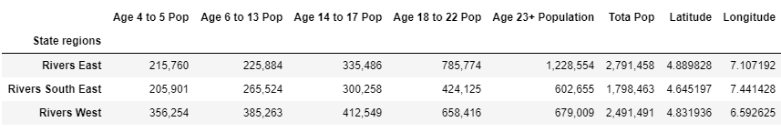
DATA DESCRIPTION AND SOURCE
It was very challenging gathering data on Nigeria
I recruited the help of a friend in Nigeria- John Ajayi. He Located data of Nigeria’s 2016 Census – https://data.world/ocha-nigeria/a7c3de5e-ff27-4746-99cd-05f2ad9b1066
OYO DATA
RIVERS DATA

Slide 5
DATA DESCRIPTION AND SOURCE
As the project progressed, I realized that foursquare does not have data on my locations of choice. Using Foursquare is required for this project
I switched to New York state and Ontario Province.
New York's population fromhttps://www.newyork-demographics.com/cities_by_population and Ontario’s population data from https://www.citypopulation.de/en/canada/cities/ontario/
Then High school Data on both Locations from Foursquare

Slide 6
METHODOLOGY
K-Means Clustering and Groupby were used to analyze the data.
Based on the table of data gathered, a city with the highest population was selected from each state. Then the data of schools in those cities were gathered using Foursquare

Slide 7
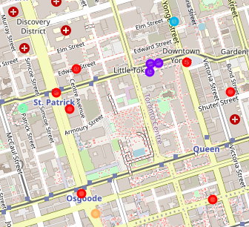
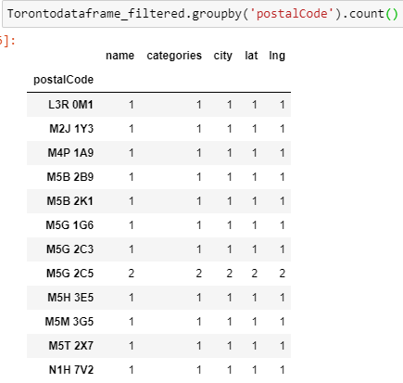
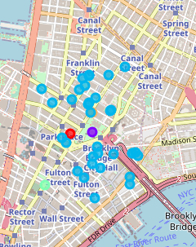
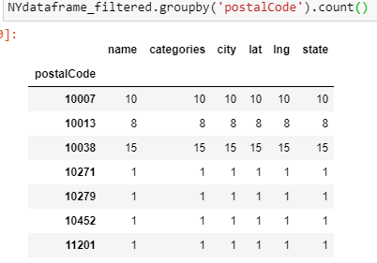
METHODOLOGY
Groupby and K-means of Toronto
Groupby and K-means of New York City

Slide 8
RESULT & CONCLUSION
For Canada, IN the analysis done, we can see that the zip code M5G 2C5 has more high schools than the other zip codes
For new York, IN the analysis done, we can see that the zip code 10038 has more high schools than the other zip codes. And following close to it is 10007.

Slide 9
RESULT & CONCLUSION
Based on the combination of highest population and k-mean, I observe that zip code 10038 in New York has more cluster of High schools among the selected cities
I would highly recommend starting an IT training business in New York city
If I was able to gather data from foursquare for the locations I had originally chosen for the project, this is the same process I would have followed to arrive at a location recommendation.

